Slide 1
Operators and Expressions and Control Statements in C#

Slide 2
Introduction
Operators
Type Casting
Type Conversion
Boxing/Unboxing
Program Control Statements

Slide 3
Operators
C# supports a rich set of operators. C# Operators can be classified into a number of related categories as below:-
Arithmetic
Relational
Logical
Assignment
Increment and Decrement
Conditional
Bitwise
Special

Slide 4
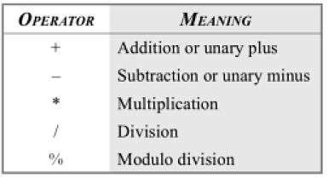
Arithmetic Operators

Slide 5
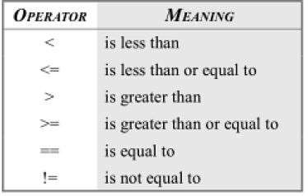
Relational Operators

Slide 6
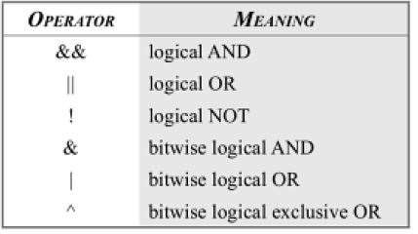
Logical Operators

Slide 7
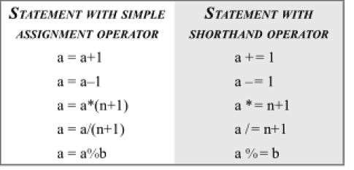
Compound Assignment Operator

Slide 8
Increment and Decrement Operator
using System; class incdecop
{
public static void Main()
{
int x=10,y=30; Console.WriteLine(“x= “ +x); Console.WriteLine(“y= “ +y); Console.WriteLine(“++x= “ ++x); Console.WriteLine(“++y= “ ++y); Console.WriteLine(“x++= “ x++); Console.WriteLine(“y++= “ y++); Console.WriteLine(“x= “ -x); Console.WriteLine(“y= “ -y); Console.WriteLine(“--x= “ --x);
Console.WriteLine(“--y= “ --y);
Console.WriteLine(“x--= “ x--);
Console.WriteLine(“y--= “ y--);
}
}

Slide 9
Conditional Operators
➢The character pair ? : is a ternary operator available in C#. This operator is used to construct conditional expression of the form
exp1 ? exp2 : exp3
➢exp1 is evaluated first. If it is true , then the expression exp2 is evaluated and becomes the value of the conditional expression.
➢If exp1 is false, exp3 is evaluated and its value becomes the value of the conditional expression.
➢ Note that only one of the expressions is evaluated.
int x=90; int y=98;
z=(x>y)? x: y;

Slide 10
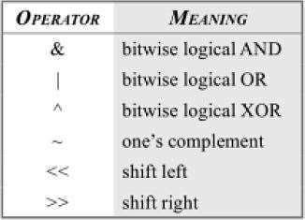
Bitwise Operators

Slide 11
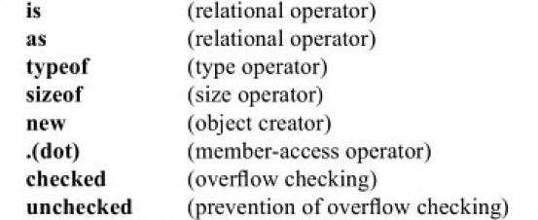
Special Type

Slide 12
// If the previous sum is attempted in a checked environment, an
// OverflowException error is raised.
// Checked expression.
Console.WriteLine(checked(2147483647 + ten));
//OR
// Checked block.
checked
{
int i3 = 2147483647 + ten;
Console.WriteLine(i3);
}

Slide 13
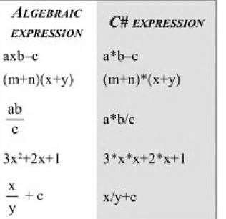
Arithmetic Expression

Slide 14
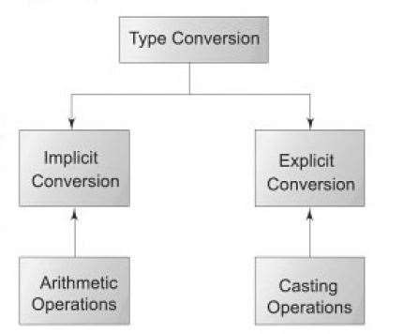
Type Conversion

Slide 15
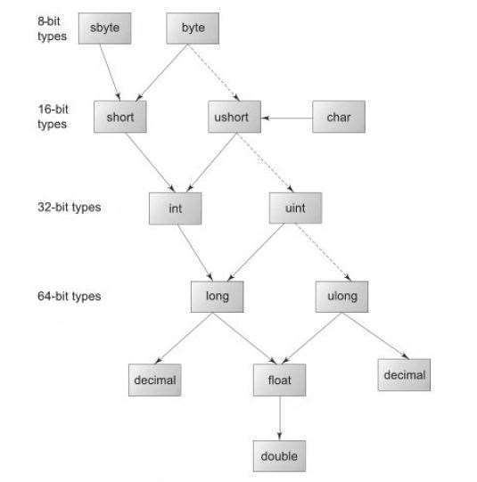
C# Conversion Chart

Slide 16
Explicit Conversion
int to short
int to uinit
uint to int
float to int
decimal to any numeric type
Any numeric type to char
Syntax: (target-type)expression
int x= 60;
byte y =(byte)x;

Slide 17
Use of Casting Operation
using System; class CastDemo
{
public static void Main()
{
int sum;
double x, y;
x=6.5;
y=2.5;
sum= (int)x/y; // x/y=2.6 but sum will be 2
Console.WriteLine(“Sum=“ +sum); //Sum= 2
}
}

Slide 18
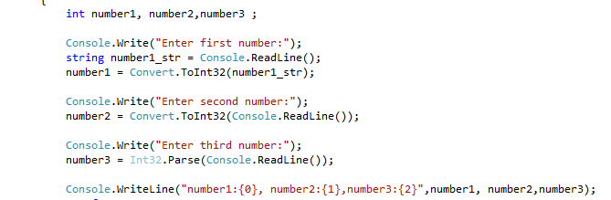
Type conversion of incompatible Data types

Slide 19
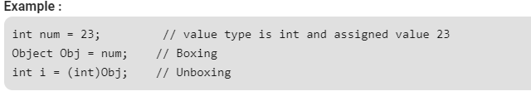
boxing and unboxing
The process of Converting a Value Type (char, int etc.) to a Reference Type(object) is called Boxing.
Boxing is implicit conversion process in which object type (super type) is used. Object is the base class for all the data types in C#.
The Value type is always stored in Stack. The Referenced Type is stored in Heap
In C#, all types, predefined and user-defined, reference types and value types, inherit directly or indirectly from Object.
The process of converting reference type into the value types known as unboxing.

Slide 20
boxing and unboxing
using System;
namespace ValueTypeTest {
class BoxingUnboxing {
static void Main()
{
int num=20;
// declare object obj
object obj=num; //implicit conversion to System.object (boxing)
num = 30;
Console.WriteLine(num); // 30
Console.WriteLine(obj); //20
// to show type of object by using GetType()
Console.WriteLine(obj.GetType()); //System.Int32
int i= (int)obj; // explicit conversion from object to int (unboxing)
Console.WriteLine(i); //20
}
}
}

Slide 21
Program control Statements
There are three categories of program control statements
Selection statements : if and switch
Iteration statements : consist of for, while, do-while, foreach loops
Jump statements: break, continue, goto, return
All the above statements of C# are same as in C/C++ and Java except foreach loop
Foreach loop cycles through the elements of a collection.
A collection is a group of objects.
C# defines several types of collections, of which one is an array
class LoopsDemo
{
static void Main()
{
int[] even={2,4,6,8,10};
Console.WriteLine(“Even Numbers);
foreach (int n in even)
{
Console.WriteLine(n);
}
}
}

